Slide 1
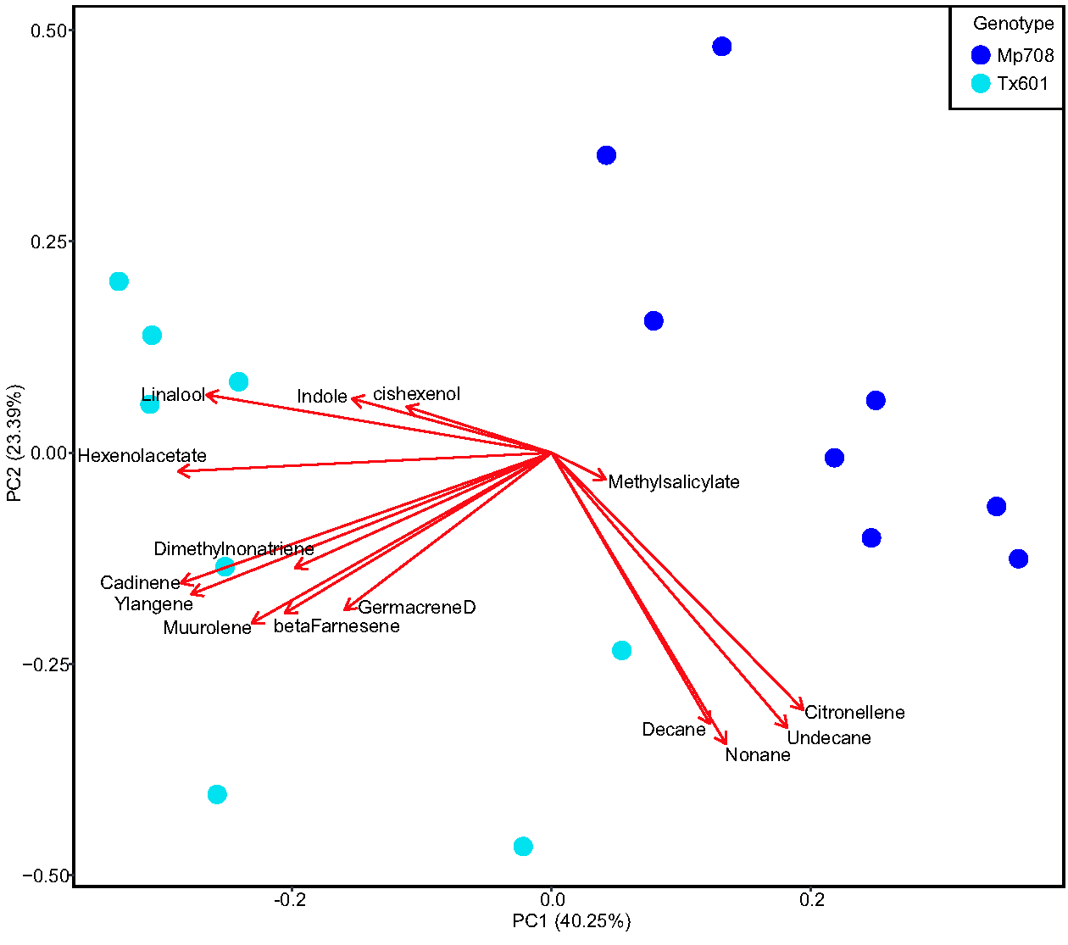
Supp. Fig. 1
Pingault et al.
Supplemental Figure 1. Principal component analysis (PCA) of the volatile organic compounds (VOCs). Mp708 and Tx601 plants are denoted with blue and turquoise, respectively.

